Slide 1
HealthConnect Clinic
Patient Attendance Analysis
Emmanuel Atuns
Data Analytics Intern
AnalystLab Africa - Week 8

Slide 2
The Problem
48.5% of appointments are missed
Impact:
- Wasted slots
- Reduced efficiency
- Poor patient outcomes

Slide 3
My Approach
- Analyzed 5,000 appointment records
- Identified no-show patterns
- Built Power BI dashboard
- Developed recommendations

Slide 4
Key Findings
Metric Value
--------------------- ----------
No-Show Rate 48.5%
Attended Rate 46.3%
Total Appointments 5,000
Reminder Effectiveness 4.0%

Slide 5
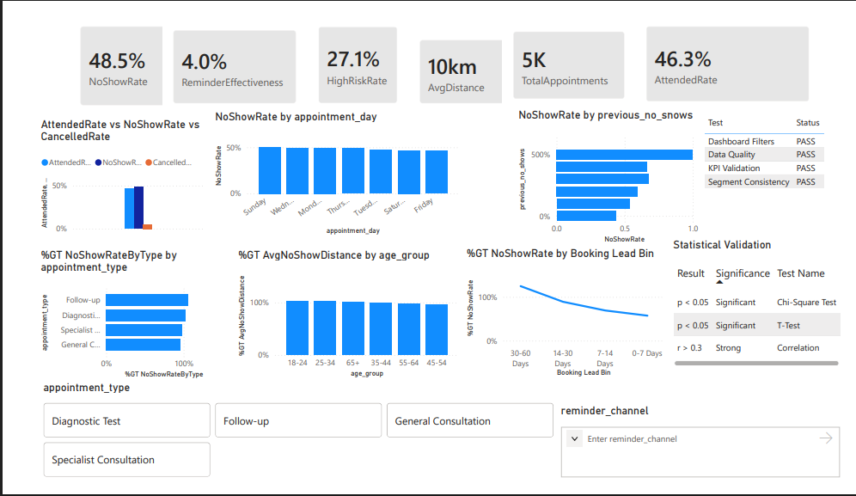
Dashboard Preview

Slide 6
Recommendations
1. Target High-Risk Patients (High)
2. Reduce Booking Lead Time (High)
3. Expand Reminder Programme (Medium)
4. Optimize Scheduling (Medium)
5. Transport Support (Low)

Slide 7
Cross-Track Collaboration
Collaborated with: Data Science Track
Provided: Validated KPIs, segment analysis
Received: Feature importance, model insights
Result: Better understanding of key predictors

Slide 8
Thank You
Thanks for listening
Emmanuel Atuns
AnalystLab Africa

